Slide 1
Water Potability Prediction Under the guidance of Prof. Dr. Abdallah Musmar
Group D - Project Members:
Mahammad Arshad Ayub Shaik (U38808804)
Payal Samanta (U76228941)
Rithika Kandimalla (U89077236)
Sasi Vardhan Reddy Poreddy (U57631677)

Slide 2
Contents
Business Problem Identification
Motivation
Dataset Overview
Features of the Dataset
Previous works
Empowering Water Safety through Business Analytics
Approach to addressing the problem
Model Application and Evaluation
Results
Conclusion
Recommendations

Slide 3
Business Problem Identification
The main objective of this project is to assess and predict water potability based on water quality attributes and obtain :
How effectively can we ensure the safety and potability of water sources for human consumption?
What measures or treatments may be necessary to meet or exceed water quality standards?

Slide 4
Motivation
Public Health Concern: Access to safe drinking water is vital for human health and well-being.
Preventing Waterborne Diseases: Ensuring water safety helps prevent diseases caused by contaminated water.
Regulatory Compliance: Compliance with water quality standards is crucial for authorities and regulatory bodies.
Real-time Monitoring: Predictive models enable real-time assessment of water quality.
Proactive Interventions: Early detection of unsafe water allows for timely interventions.
Resource Allocation: Efficient allocation of resources for water treatment and management.

Slide 5
Dataset Overview
This dataset contains water quality measurements and assessments related to potability, which is the suitability of water for human consumption.
It can be utilized by water treatment plants, environmental agencies, and researchers to make data-driven decisions regarding water quality and potability.
Source : Datasets/water_potability.csv at master · MainakRepositor/Datasets · GitHub

Slide 6
Features of the dataset
pH: The pH level of the water.
Hardness: Water hardness, a measure of mineral content.
Solids: Total dissolved solids in the water.
Chloramines: Chloramines concentration in the water.
Sulfate: Sulfate concentration in the water.
Conductivity: Electrical conductivity of the water.
Organic_carbon: Organic carbon content in the water.
Trihalomethanes: Trihalomethanes concentration in the water.
Turbidity: Turbidity level, a measure of water clarity.
Potability: Target variable; indicates water potability with values 1 (potable) and 0 (not potable).

Slide 7
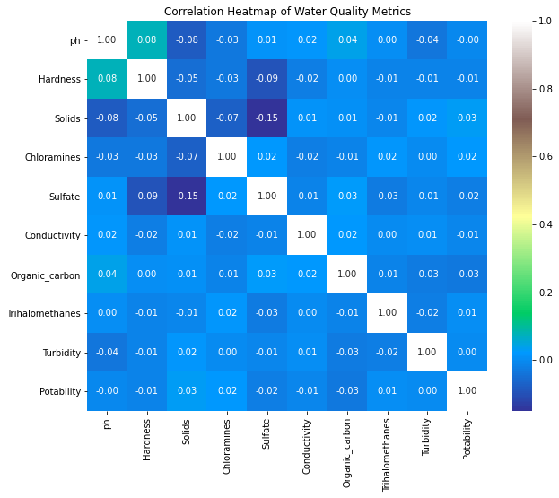

Slide 8
Previous works
Problem Solving Approach: A structured approach by exploring and visualizing the data to understand the key trends and patterns, ensuring the foundation for model development was robust.
Strategic Model Choice: Focused on a single algorithm aligning with the objective of achieving a high-quality predictive model.
Performance Metrics: Adopted a multi-metric evaluation strategy, ensuring a comprehensive assessment of the model's capability to meet business objectives.

Slide 9
Empowering Water Safety through Business Analytics
Finding out What Makes Water Safe
Getting Better at Predicting Water Safety
Making Smart Choices and Rules for Water
Using Resources Wisely
Keeping People Healthy and Safe

Slide 10
Approach to addressing this problem
a. Data Used/Found/Derived:
A robust dataset featuring essential parameters like pH levels and sulfate content was employed to ascertain water potability in this project. Through meticulous cleaning and preprocessing, the data was optimized, laying a strong foundation for reliable and accurate predictive model development.
b. Models Chosen to Apply and Test:
Various machine learning models, including the RandomForestClassifier, were meticulously applied and tested to identify optimal solutions for predicting water potability. A rigorous approach, encompassing hyperparameter tuning and extensive validation practices, was adopted to optimize each model, reflecting a dedicated commitment to developing a reliable and impactful predictive solution.

Slide 11
Model Application and Evaluation
Steps followed through out this project:
1. Data Preprocessing and Upsampling: A crucial objective in the preprocessing stage was to manage class imbalance through upsampling techniques. This ensured a more balanced dataset, which is pivotal for enhancing the model's predictive accuracy and robustness.
2. Model Selection and Application: Various models, including the RandomForestClassifier, were meticulously applied, leveraging the enhanced dataset to make more balanced and accurate predictions regarding water potability.
3. Model Evaluation: Comprehensive evaluation metrics such as accuracy, classification reports, and confusion matrices were employed. These metrics facilitated a thorough assessment of the models, providing detailed insights into their predictive performance and reliability.

Slide 12
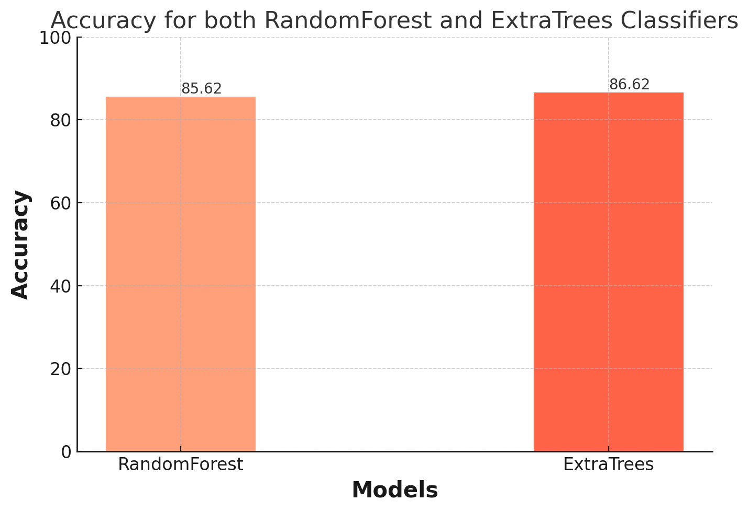
Results

Slide 13
Conclusion
The application of upsampling techniques in preprocessing played a pivotal role in enhancing the models' performance, ensuring that they were trained on a more balanced representation of the data.
The models, particularly the RandomForestClassifier, were evaluated with a focus on their predictive accuracy, precision, recall, and F1-score, offering a multifaceted view of their effectiveness.
The detailed results, including classification reports and confusion matrices, provided valuable insights into the models' capabilities, demonstrating the impact of upsampling in improving predictive outcomes in water potability.
Incorporating upsampling as a key preprocessing objective significantly contributed to the refinement of the models, enhancing their ability to provide reliable and balanced predictions regarding water potability.

Slide 14
Recommendations
Model Selection: Considering the slightly higher accuracy and consistent precision and recall rates, the ExtraTrees classifier may be favored for predicting water potability in this case.
Feature Importance Analysis: Conducting a feature importance analysis could provide insights into which water quality attributes most significantly influence the potability prediction, guiding future data collection and analysis.
Further Tuning and Validation: Continue exploring hyperparameter tuning and cross-validation techniques to enhance model robustness and performance. Also, consider exploring other algorithms and ensemble methods for potential improvements.
Real-world Validation: Before deploying the chosen model in a real-world scenario, it is recommended to validate the model using new, unseen data to ensure its reliability and robustness in various conditions.

